Slide 1


Project Title: Demand Forecasting Using Smart Logistics Data
Name: Chukwudi Emmanuel Ekweani
Learner ID: 141451
Course: BAN6800: Business Analytics Capstone
Date: April 2025

Slide 2
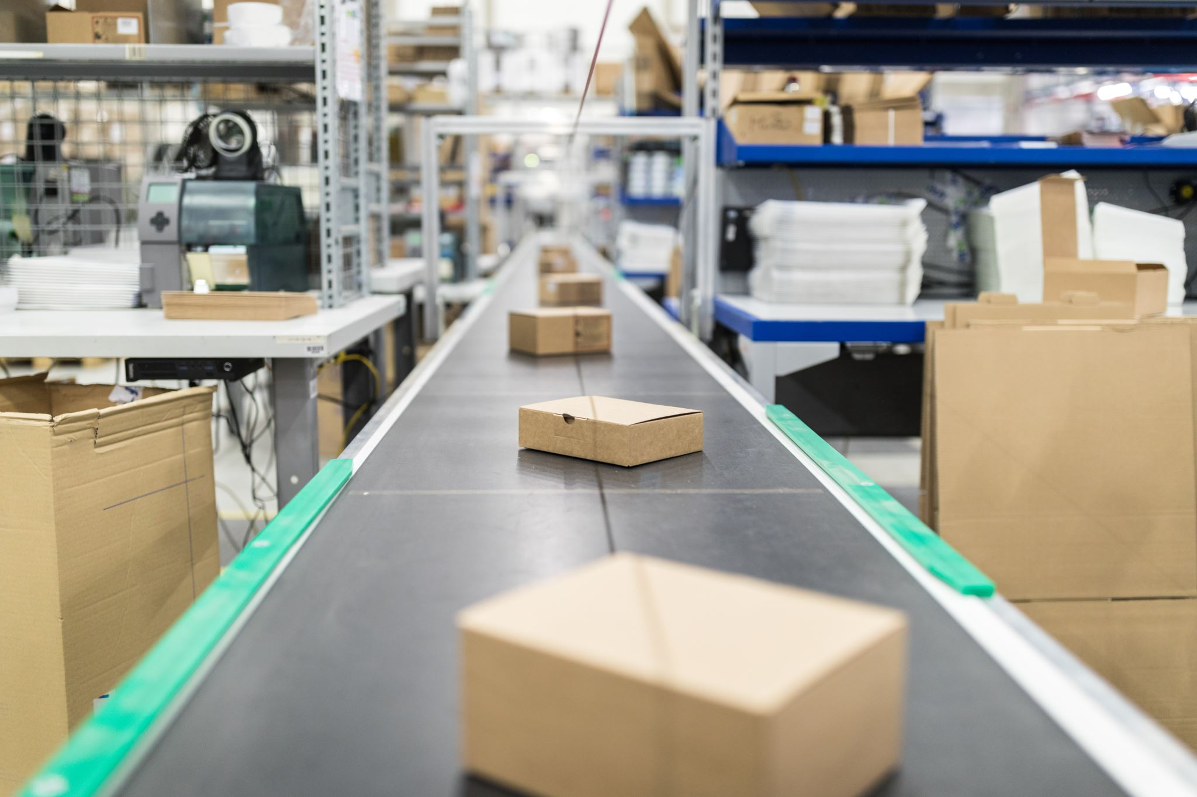
Project Overview
This project aims to enable us to be able to predict part-time how much product we are going to need. When we know this, we will be able to manage our supply by not having too much or too little of them.

Slide 3
The Problem
Often times, we see a situation whereby businesses overstock and end having too many products that they are stock with because they couldn’t sell them.
And on the other we encounter an even worse situation where a business don’e have enough to meet up with the needs of their customers.
We want to find a better and more efficient way to predict what will be needed, and when.

Slide 4
About The Data
In this project, I made use of a dataset called Smart Logistics that I got from the kaggle website via this link:
https://www.kaggle.com/datasets/ziya07/smart-logistics-supply-chain-dataset
The dataset consists of 1,000 rows and 16 columns, and includes:
When items were shipped
Product inventory and demand
Weather, traffic, and delivery information.

Slide 5
Tools I Used
I used Python to work on the data
I made use of the Pandas library to clean and organize the data
Jupyter notebook was used for the analysis
I created charts with Matplotlib and Seaborn

Slide 6
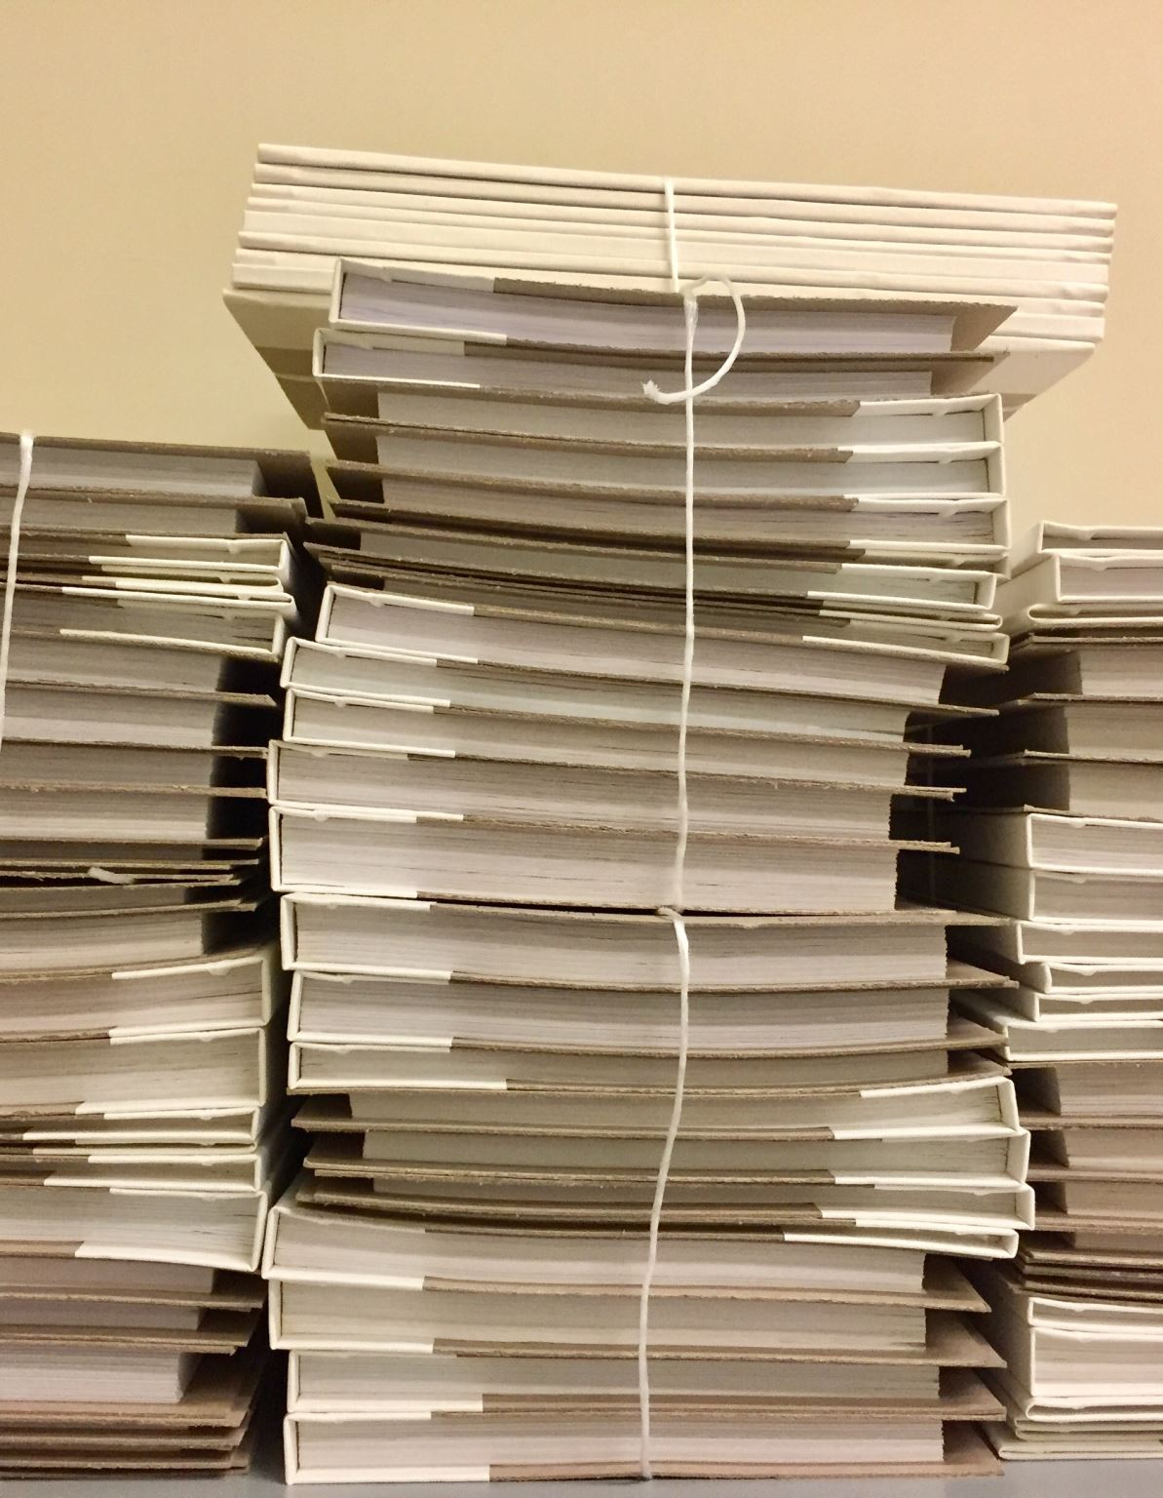
How I Cleaned The Data
I made sure that each column had the right data type
I changed the date columns to the format. It was an object before I changed it into a date type.
Every missing and strange value was addressed.

Slide 7

Feature Engineering
I added new columns like:
Time of the day and day of the week
Efficiency Ratio = Demand / Inventory
A flag to show if there was a delivery delay reason
I grouped the inventory into categories (Low, Medium, and High)

Slide 8
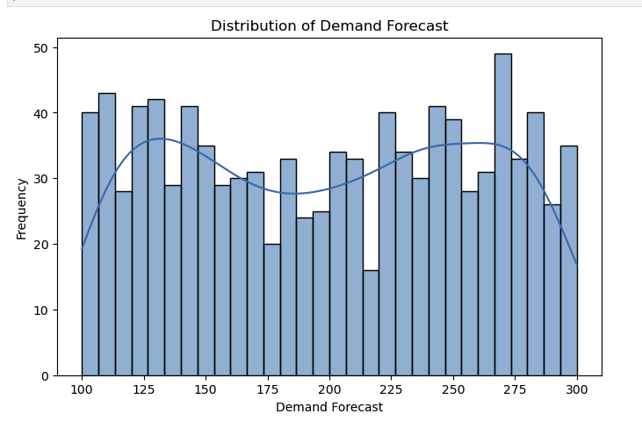
How Demand Is Spread Out
Most of the values of demand are between 150 and 275
The average demand is around 200
This gives us a normal range.

Slide 9
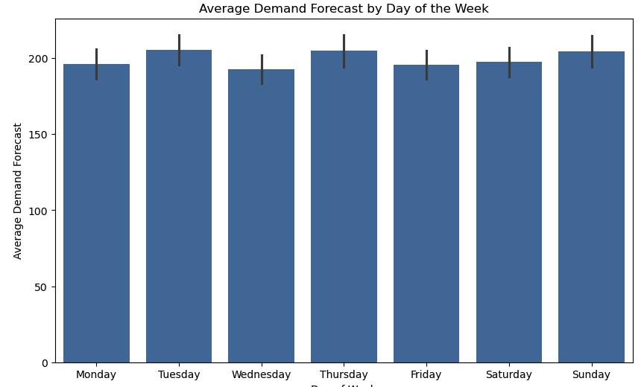
Demand by Day of the Week
It was observed that people ordered more on the following days:
Tuesday
Thursday
Sunday
This helps us to know the busy days.

Slide 10
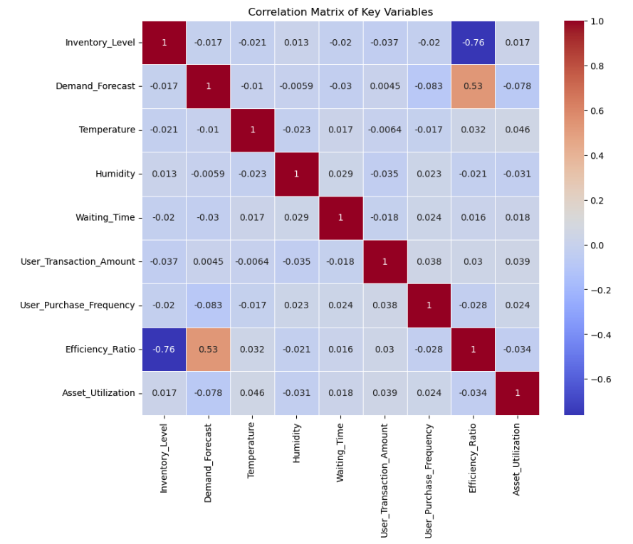
Correlation Analysis (Which of The Features are Most Connected to Demand?)
From the analysis, the Efficiency Ratio is the best match with demand.
Surprisingly, factors like weather and waiting time don’t really affect demand.
So when predicting, we should focus on efficiency.

Slide 11
Findings
Most demands fall between 150 and 275
The days with the highest demand are Tuesdays, Thursdays, and Sundays.
Efficiency is the most important factor that affects demand
Weather and traffic don’t really affect or change the wants of people.

Slide 12

Data Quality and Fairness
The data is clean and complete
No personal or sensitive information was added to the dataset
The data was fair. There was no form of bias.

Slide 13

Data Readiness
After the entire process of cleaning and feature engineering, the data is now ready to use in a model that can predict future demand.
The next thing is to build a model that will predict future demands, create a dashboard for quick insights, and help the business stock up the right way according to predictions.

Slide 14

Files and Links
Cleaned dataset saved as a CSV file
Python notebook showing all my steps
https://github.com/Chukzimmani/projects/tree/main/BAN6800%20Milestone%201%20Assignment

